Slide 1
CONTROL STRUCTURES

Slide 2
Boolean and Logical Operator
In C++ logical data declared as bool data type
  e.g.
    bool variable_name;
There are only two values: true and false
Type-casting bool to int:
  true => 1
  false => 0
  Example
int number;
number = 2 + true;
cout << number; //output: 3

Slide 3
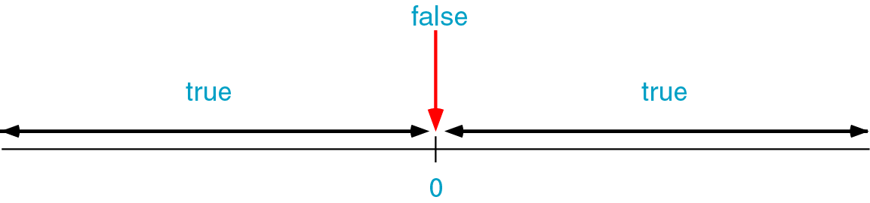
Boolean and Logical Operator
Type-casting int to bool:
  A Zero value => false
  A Non-Zero value => true
Example:
bool b = false; // b initially is false
int number = 0;
b = -10; // Now, b is true
b = number; // Here, b is false again

Slide 4
Boolean and Logical Operator
  What would be printed by this code segment
bool b;
int p;
int q = 5;
b = q;
p = b;
cout << “The value of p is ” << p << endl;
Output:
The value of p is 1

Slide 5
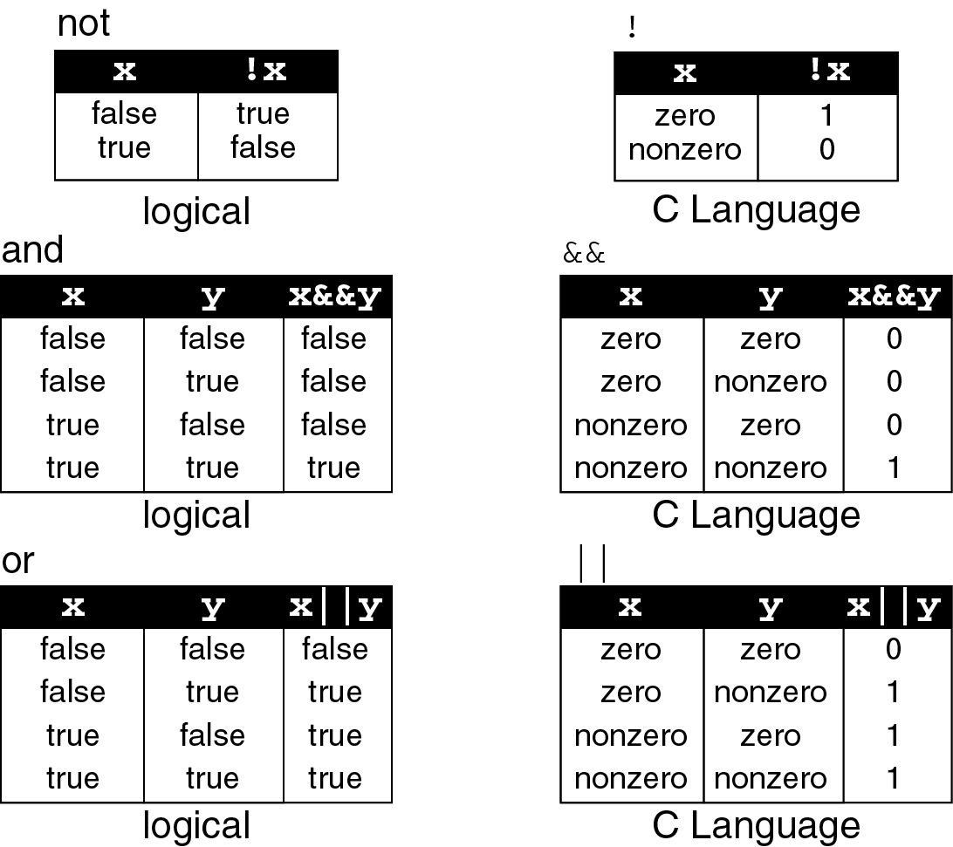
Logical operators truth table

Slide 6
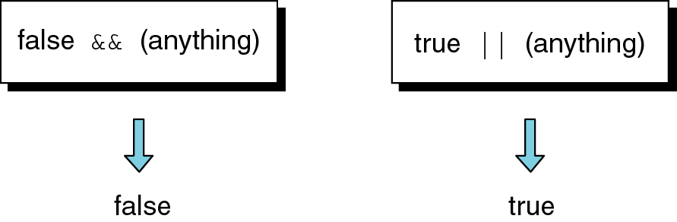
Operations for logical and/or

Slide 7
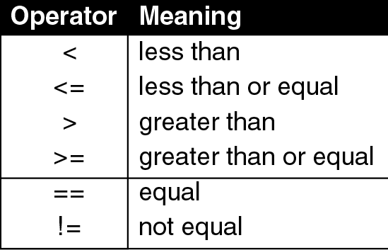
Relational operators

Slide 8
Logical expression
  Example:
int a=10;
cout << a;
cout << (a==1);
cout << (a>1);
cout << (a=5);
a = (a != 5);
out << a;
Prints 10
Prints 0. Is 10==1 ? => false =>0
Prints 1. Is 10>1 ? => true => 1
Prints 5. This is not a logical expression. It is an assignment expression.
Prints 0. Is 5!=5 ? => false =>0

Slide 9
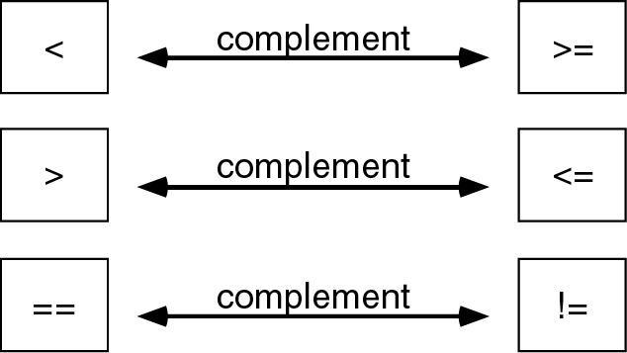
Logical operator complements
Another way to complement an expression is just putting a Not operator (!) in front of it.
  Example: Complement of n==0 is
  !(n==0)

Slide 10
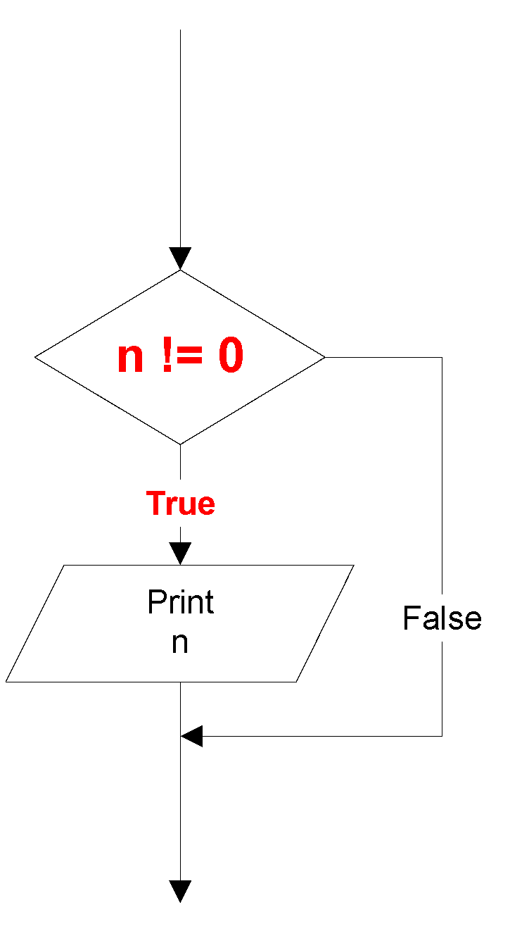
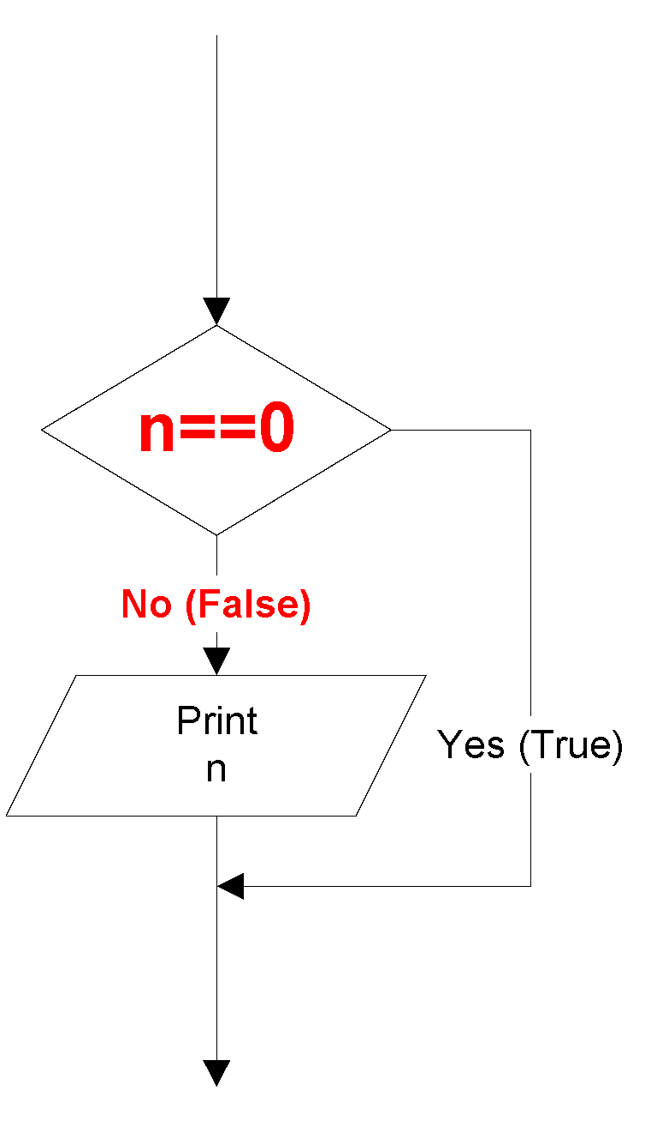
When to use complement?
  Example 1:
Solution: Complement the condition.
!(n==0) or n != 0
In order to convert the flowchart to C++ code, this part must be a “Yes (True)”

Slide 11
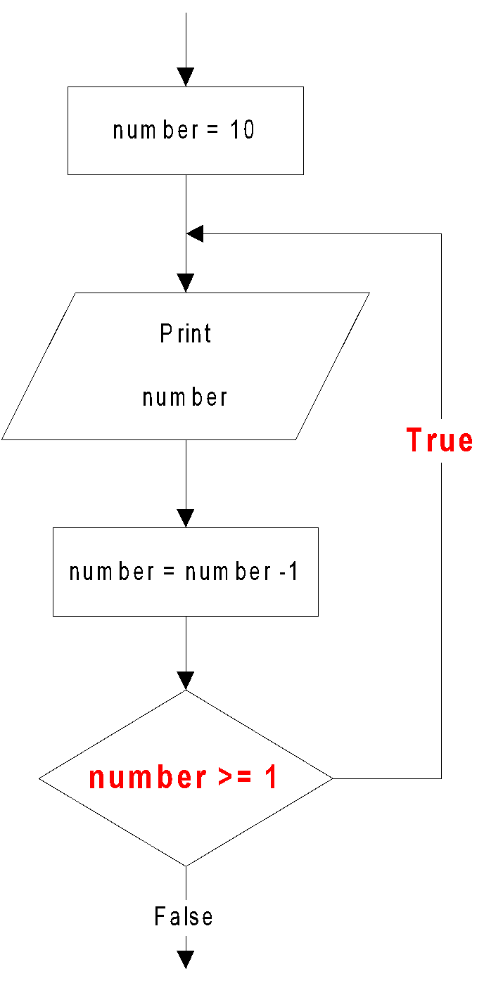
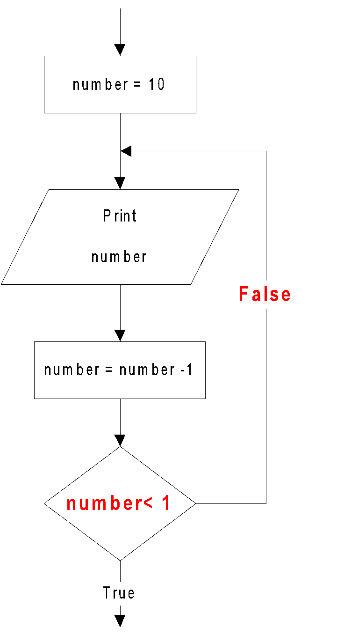
When to use complement?
  Example 2:
The iteration part must be a True
Solution: Complement the condition.
!(number<1) or (number >=1)

Slide 12
Selection / Branch
Sometimes your programs need to make logical choices.
Example:
IF score is higher than 50
THEN grade is PASS
ELSE grade is FAIL
In C++, this corresponds to if statement with three parts:
if (score > 50) //part 1
{
grade = PASS; //part 2
}
else
{
grade = FAIL; //part 3
}

Slide 13
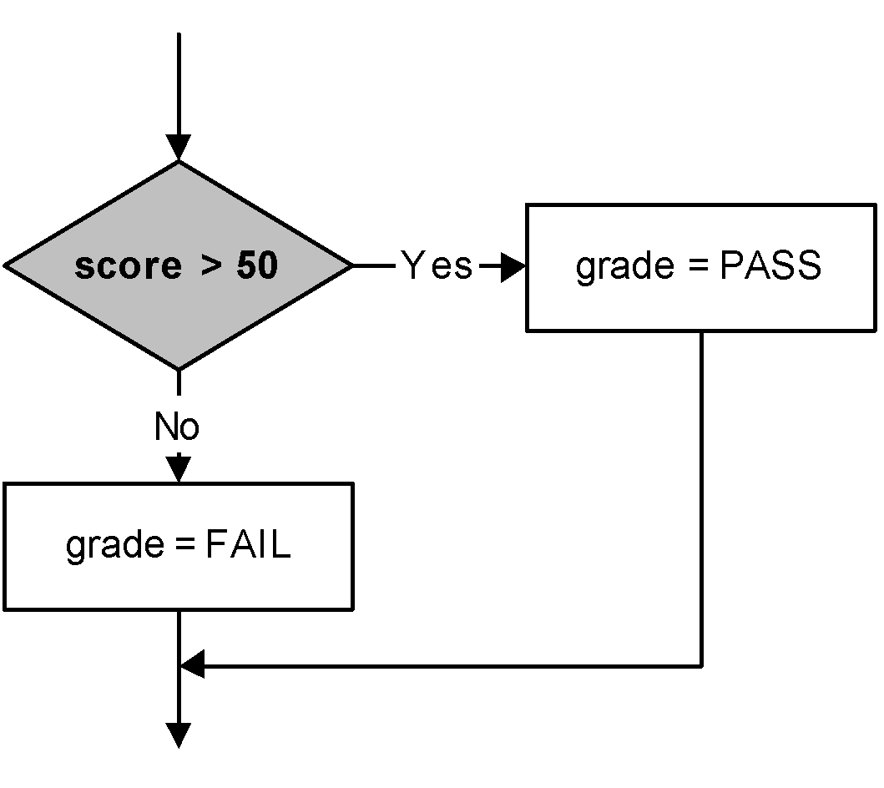
if statement
Part 1 : the condition - an expression that evaluates to true or false.
if (score > 50)
{
grade = PASS;
}
else
{
grade = FAIL;
}

Slide 14
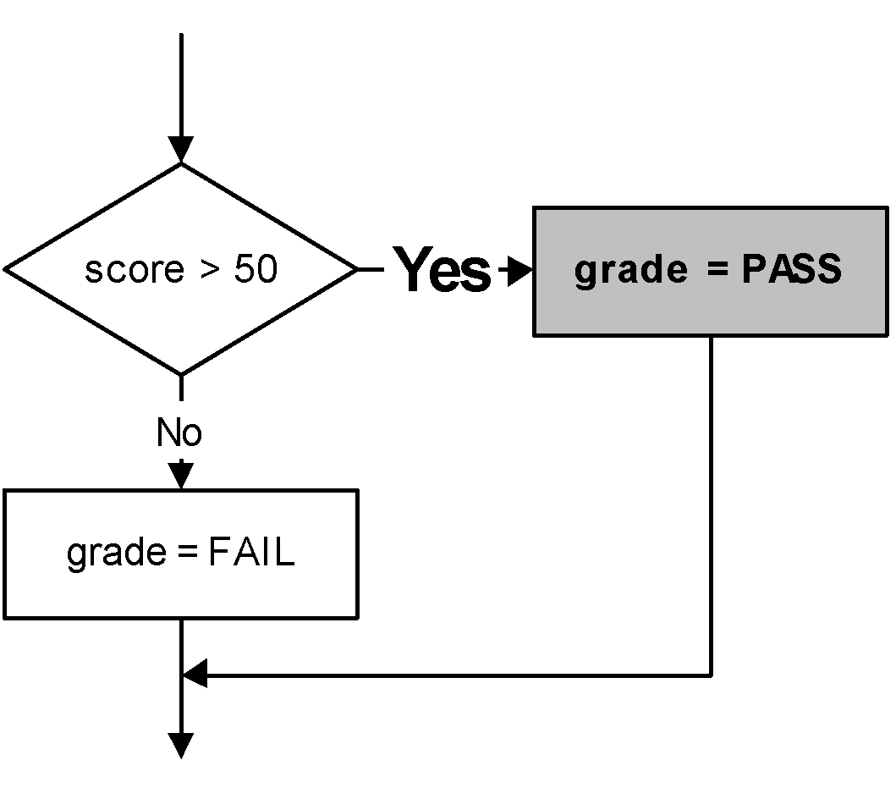
if statement
Part 2 : the TRUE-PART - a block of statements that are executed if the condition evaluates to true
if (score > 50)
else
{
grade = FAIL;
}
{
grade = PASS;
}

Slide 15
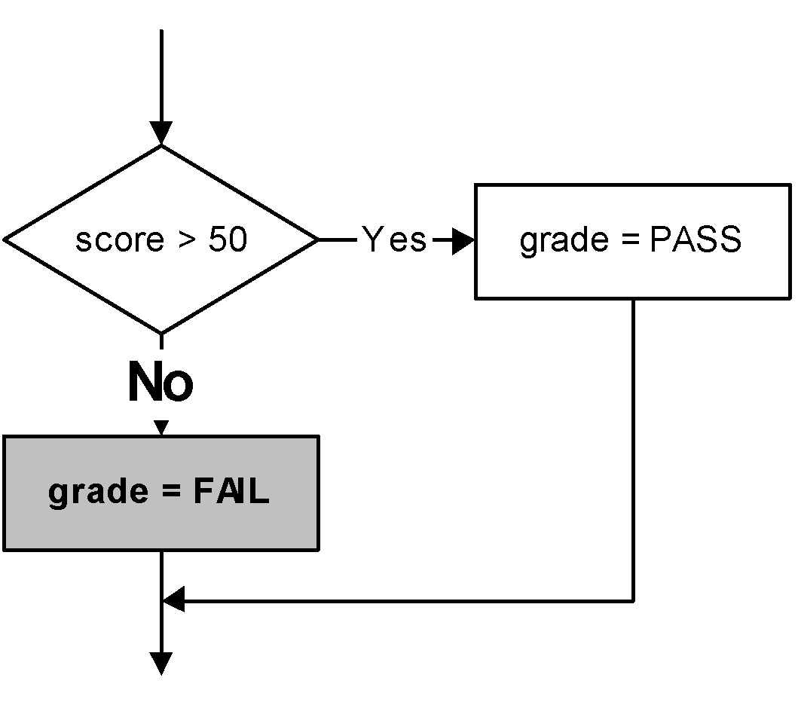
if statement
Part 3 : the FALSE-PART - a block of statements that are executed if the condition evaluates to false
if (score > 50)
{
grade = PASS;
}
else
{
grade = FAIL;
}
if the condition
evaluates to false,
the TRUE-PART is skipped.

Slide 16
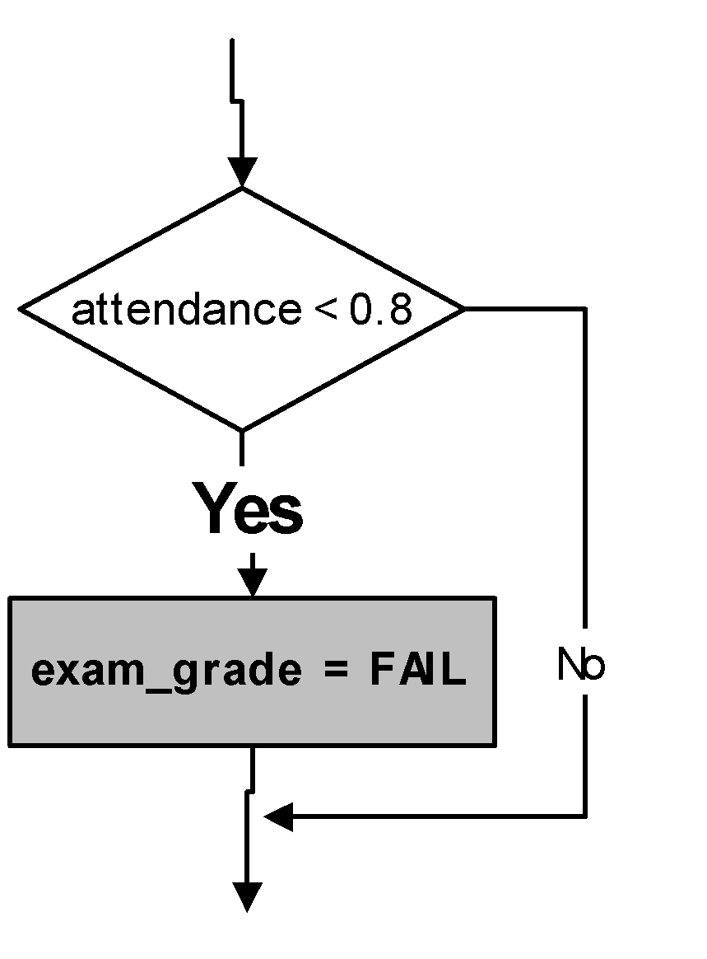
if statement
Sometimes there is no FALSE-PART. The “else” is omitted
if ( attendance < 0.8 )
{
exam_grade = FAIL;
}

Slide 17
if statement
If the TRUE-PART (or FALSE-PART) consists of only one statement, then the curly braces may be omitted.
Example: these two statements are equivalent:
if (score > 50)
{
grade = PASS;
}
else
{
grade = FAIL;
}
if (score > 50)
grade = PASS;
else
grade = FAIL;

Slide 18
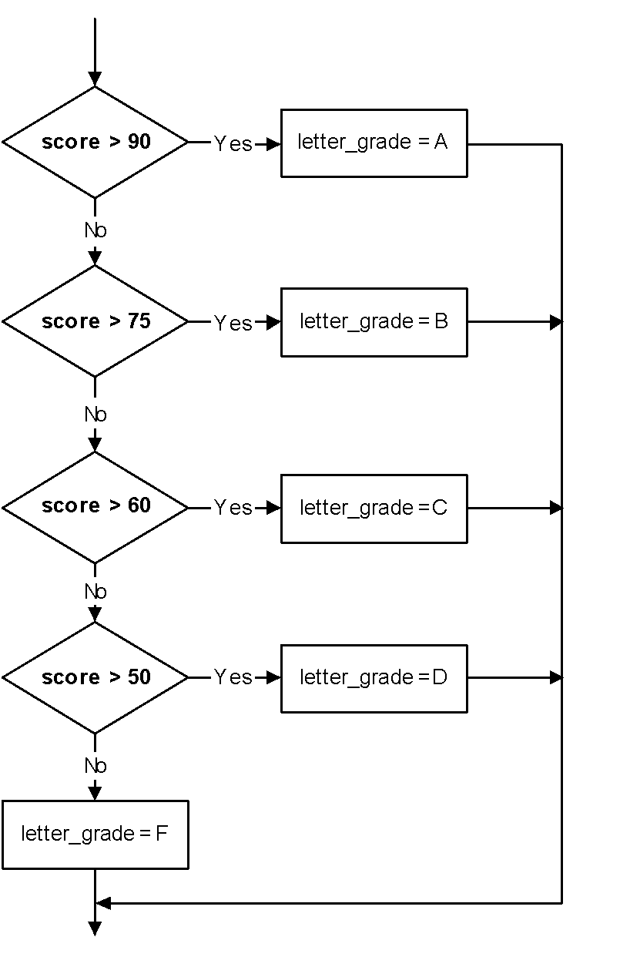
if statement
Sometimes there are more than two parts. In those cases you may use nested if-else statements:
if (score > 90)
letter_grade = 'A';
else if (score > 75)
letter_grade = 'B';
else if (score > 60)
letter_grade = 'C';
else if (score > 50)
letter_grade = 'D';
else
letter_grade = 'F';

Slide 19
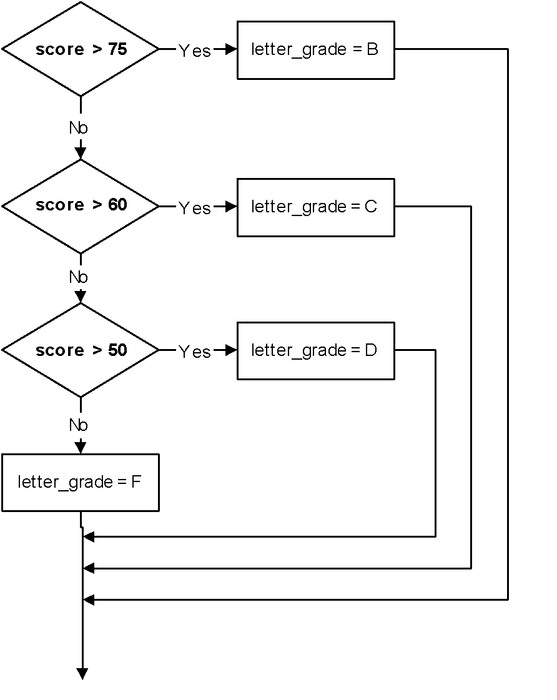
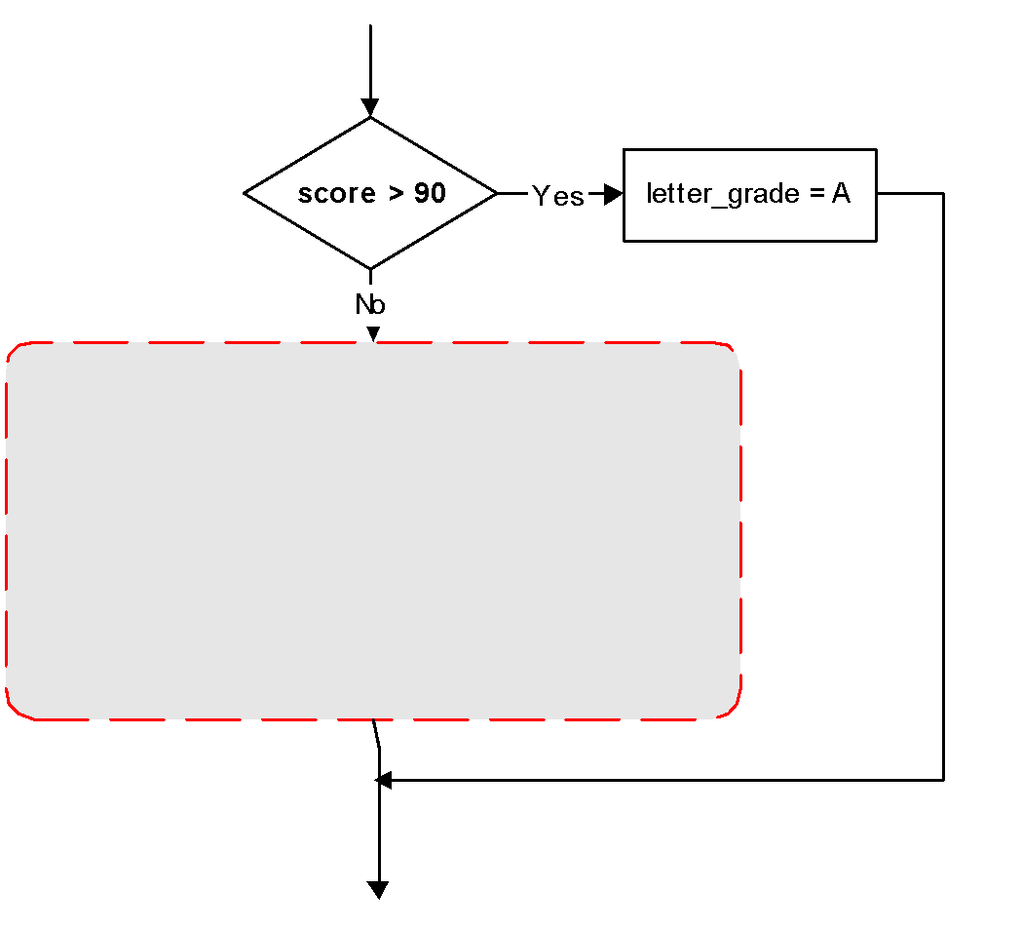
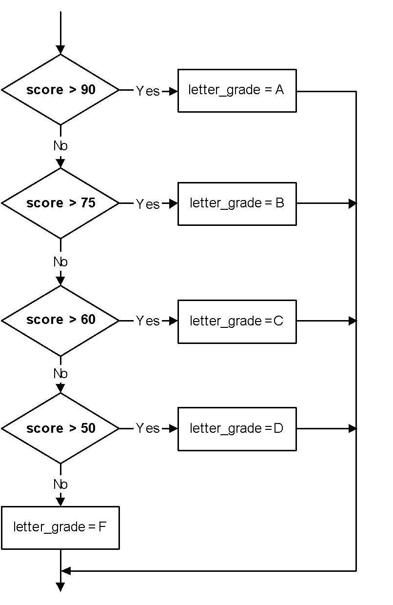
Let’s look closer
It is actually a regular if-else with the FALSE-PART is another if-else statement
If (score>50)
{
letter_grade = ‘A’;
}
else {
……..
…….
}

Slide 20
if statement
Three forms of if statements are shown at the next table.
The condition must be placed in parentheses
Statement may exist either as a single statement or as a collection of statements (also called compound statement)
if(condition)
statement;
if (condition)
{ statement;
statement;
}
if (condition)
{ statement;
statement;
}
else
{ statement;
statement;
}

Slide 21
A compound statement is one or more statements that are grouped together by enclosing them in brackets , {}.
Example:
if (value > 0)
cout << value;
value = value * 2;
if (value > 10)
{
value = 10;
cout << value;
}
This is a single statement. The semi-colon belongs to “if” not to “cout”
a single statement
This is a compound statement which consists two single statements.

Slide 22
Related issues
The condition must be placed in parentheses
Example:
if (0<x) && (x<10) //syntax error
cout << x;
Correction:
if ((0<x) && (x<10)) // place both conditions into
// a parentheses
cout << x;

Slide 23
Related issues
But be careful when converting mathematical comparisons. Some of them are not straight forward
There is no syntax error, but this leads to a logic error due to the misinterpretation.
The condition always evaluates to true, whatever the value of x
Example: Print x only if (2<x<9)
if (2 < x < 9)
cout << x;
Let say x=1
(2<x<9)
(2<1<9)
(false<9)
(0<9)
true
Let say x=5
(2<x<9)
(2<5<9)
(true<9)
(1<9)
true
Correction:
if ((2 < x) && (x < 9))
cout << x;

Slide 24
Related issues
The condition must evaluate to a Boolean value (i.e. either true or false)
There are only two types of expression that result a Boolean value
  Comparison expression (e.g. a>2 )
  Boolean expression (e.g. b && false )
If the result of the condition is not a Boolean, it will be type-casted
The condition evaluates to 0. It then is type-casted to Boolean, becomes false
Example:
int n=0;
if (n)
cout << “Yes”;
else
cout << “No”;
Output:
No

Slide 25
Example:
The condition evaluates to 5. It then is type-casted to Boolean, becomes true
int n=0;
if (n + 5)
cout << “Yes”;
else
cout << “No”;
Output:
Yes

Slide 26
Example:
Remember! This is an assignment expression, not an equality.
The value of the expression is 0. It then is type-casted to Boolean, becomes false. The result is always false.
int x=0;
if (x=0)
cout << “Yes”;
else
cout << “No”;
Output:
No

Slide 27
Example:
Remember! This is an assignment expression, not an equality.
The value of the expression is 10. It then is type-casted to Boolean, becomes true. The result is always true.
int y=5;
if (y=10)
cout << “Yes”;
else
cout << “No”;
Output:
Yes

Slide 28
Example:
Remember! This is an assignment expression.
The condition always evaluates to true. The value of y is changed to 5 due to the side-effect caused by the assignment operator
int y=1;
if (y=5)
cout << y;
Output:
5

Slide 29
Related issues
Be careful when using the Boolean operator NOT (!)
Example:
int n=5;
if (!n>9)
cout << “Yes”;
else
cout << “No”;
Operator ! has higher precedence then operator >. So, it is executed first.
Expression !n is evaluated as !true where n is type-casted from integer 5 to Boolean true. The result is false
The expression is further evaluated as (false>9).
The false value is then type-casted to 0, since it will be compared with an integer. The expression then looks like (0 > 9) and the final result is false
Output:
No

Slide 30
Example:
int n=5;
if (!(n>9))
cout << “Yes”;
else
cout << “No”;
(!(n>9))
(!(n>9))
(!(5>9))
(!(false))
(!false)
true
Output:
Yes

Slide 31
Related issues
Statements should be indented correctly to avoid misinterpretations
Example:
Let say x=1,
Condition => true
Output:
Let say x=3
Condition => false
Output:
if (x<3)
cout <<"Yes" << endl;
cout <<"No" << endl;
Yes
No
No
The second cout doesn’t belong to if statement. It is on its own but was indented incorrectly.
Correction:
if (x<3)
cout <<"Yes" << endl;
cout <<"No" << endl;

Slide 32
Example:
if (x<y)
cout << x;
x = y;
else
cout << y;
Syntax error – misplace else.
There must only be a single statement before else. If more than that, use a compound statement.
Correction:
if (x<y)
{
cout << x;
x = y;
}
else
cout << y;

Slide 33
Example:
Print x only if it is an odd number less than 10, otherwise print “Wrong number”
if (x%2==1)
if (x<10)
cout <<x;
else
cout << “Wrong number”;
Let say x=7,
Output:
Let say x=11,
Output:
7
Wrong Number
Correct!
Correct!
But, when x=12,
There is no output. This is incorrect.
It suppose to print “Wrong number”
There is no syntax error, but this leads to a logic error due to the misinterpretation.
The else part actually belongs to the second if (if (x<10) ), not to the first one
Correction: use brackets {}
if (x%2==1)
{
if (x<10)
cout << x;
}
else
cout << “Wrong number”;

Slide 34
Related issues
Null statements are statements that do nothing
Example:
The semi-colon represents a null statement. Either the condition evaluates to true or false, there is nothing to do.
if (x<3);
cout <<"Yes";
The cout doesn’t belong to if statement. The statement has already been ended up with semi-colon previously.
The output is always:
Yes

Slide 35
Let say x=5,
Output:
Let say x=1,
Output:
Example:
No
Yes
No
if (x<3)
cout <<"Yes“ <<endl;
else;
cout <<“No” <<endl;
The semi-colon represents a null statement.
This cout doesn’t belong to else part.

Slide 36
Simplifying if statements
Simplifying conditions:
Original statement
Simplified statement
if ( a != 0 )
statement;
if ( a )
statement;
if ( a > 0 )
statement;
if ( a < 0 )
statement;
if ( a == 0 )
statement;
if ( !a )
statement;

Slide 37
Simplifying if statements
Example 1 : print a number only if it is an odd number
Original statement
Simplified statement
if ( n%2==1 )
cout << n;
if ( n%2 )
cout << n;
Example 2: print a number only if it is an even number
Original statement
Simplified statement
if ( n%2==0 )
cout << n;
if ( !(n%2) )
cout << n;

Slide 38
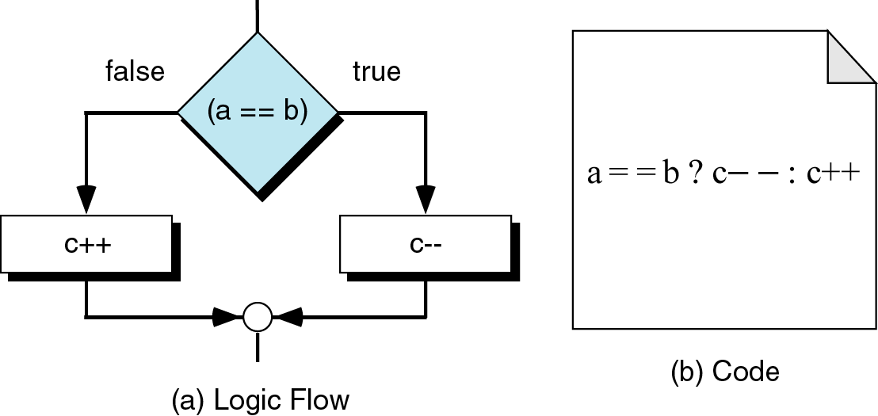
Simplifying if statements
Conditional Expressions:

Slide 39
Simplifying if statements
Conditional Expressions:
If the condition is true, take the value1
If the condition is false, take the value2
Syntax:
condition ? value1 : value2
Example:
if (p<5)
p = q + 1;
else
p = 5;
This statement means
p = (p<5) ? q + 1 : 5;

Slide 40
switch statement
If there are many nested if/else statements, you may be able to replace them with a switch statement:
switch (letter_grade)
{
case 'A‘ : cout <<"Excellent!";
break;
case 'B' : cout <<“Very good!";
break;
case 'C' : cout <<"Good";
break;
case 'D' : cout <<"Adequate";
break;
default : cout <<"Fail";
break;
}
if (letter_grade == 'A')
cout << “Excellent!";
else if (letter_grade == 'B')
cout << "Very good!";
else if (letter_grade == 'C')
cout << "Good";
else if (letter_grade == 'D')
cout << "Adequate";
else
cout << "Fail";

Slide 41
switch statement
switch (expression)
{
case value1: statements_1;
break;
case value2 : statements_2;
break;
...
default : statements;
break;
}
How the switch statement works?
Check the value of expression.
Is it equal to value1?
  If yes, execute the statements_1 and break out of the switch.
  If no, is it equal to value2? etc.
If it is not equal to any values of the above, execute the default statements and then break out of the switch.

Slide 42
switch statement
Example 1:
int value = 1;
switch (value)
{
case 1: cout << “One”;
break;
case 2: cout << “Two”;
break;
default : cout << “Neither One nor Two”;
break;
}
evaluates to 1
Prints One
it is equal to this case-value (i.e. 1==1). So, execute the statements of ‘case 1’.
break out of the switch
Output:
  One

Slide 43
switch statement
Example 2:
int value = 1;
switch (value + 1)
{
case 1: cout << “One”;
break;
case 2: cout << “Two”;
break;
default : cout << “Neither One nor Two”;
break;
}
this expression evaluates to 2
it is not equal to this case-value (i.e. 2!=1). So, skip the statements of ‘case 1’ and move to the next case.
Prints Two
it is equal to this case-value (i.e. 2==2). So, execute the statements of ‘case 2‘.
break out of the switch
Output:
  Two

Slide 44
switch statement
Example 3:
int value = 5;
switch (value)
{
case 1: cout << “One”;
break;
case 2: cout << “Two”;
break;
default : cout << “Neither One nor Two”;
break;
}
evaluates to 5
The switch expression (i.e. 5) is not equal to
both cases (i.e 5!=1 and 5!=2). So, their statements are skipped.
When the ‘default case’ is reached, its statements are always executed.
Prints Neither One nor Two
break out of the switch
Output:
  Neither One nor Two

Slide 45
switch statement
What if the break statement is not written?
int value = 1;
switch (value)
{
case 1: cout << “One\n”;
case 2: cout << “Two\n”;
break;
default : cout << “Neither One nor Two\n”;
break;
}
evaluates to 1
it is equal to this case-value (i.e. 1==1). So, execute the statements of the ‘case 1’.
Prints One
No break statement here. So, no break out and move to the next line.
Prints Two
break out of the switch
Output:
  One
  Two

Slide 46
switch statement
The switch expression must be of integral type (i.e. int,char,bool).
The following examples would be an error
void main()
{
float point=4.0;
int mark;
switch (point)
{
case 4 : mark = 100;
break;
case 3.7 : mark = 80;
break;
default : mark = 0;
break;
}
}
void main()
{
char name[]="Ali";
int mark;
switch (name)
{
case "Ali" : mark=95;
break;
case "Aminah": mark=90;
break;
default : mark=50;
break;
}
}
Error! The switch expression cannot be a float value
Error! The switch expression cannot be a string value

Slide 47
switch statement
The case-value must be a constant (literal, memory or defined constant)
The following example would be an error
void main()
{
#define DEFINE 1
const int const2=2;
int var3 = 3;
int value;
switch (value)
{ case 0 : cout << "Four";
break;
case DEFINE : cout << "One";
break;
case const2 : cout << "Two";
break;
case var3 : cout << "Three";
break;
}
}
a literal is OK
a defined constant is OK
a memory constant is OK
Error! case-value cannot be a variable

Slide 48
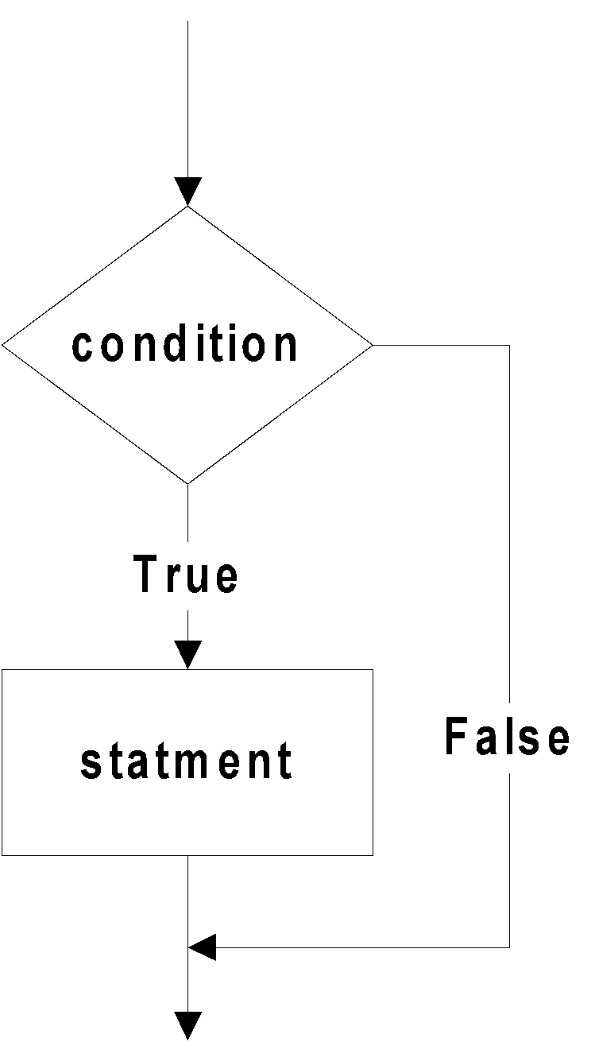
Translating flowchart to C++ code
Pattern 1
if (condition)
{
statement;
}
This must be a True

Slide 49
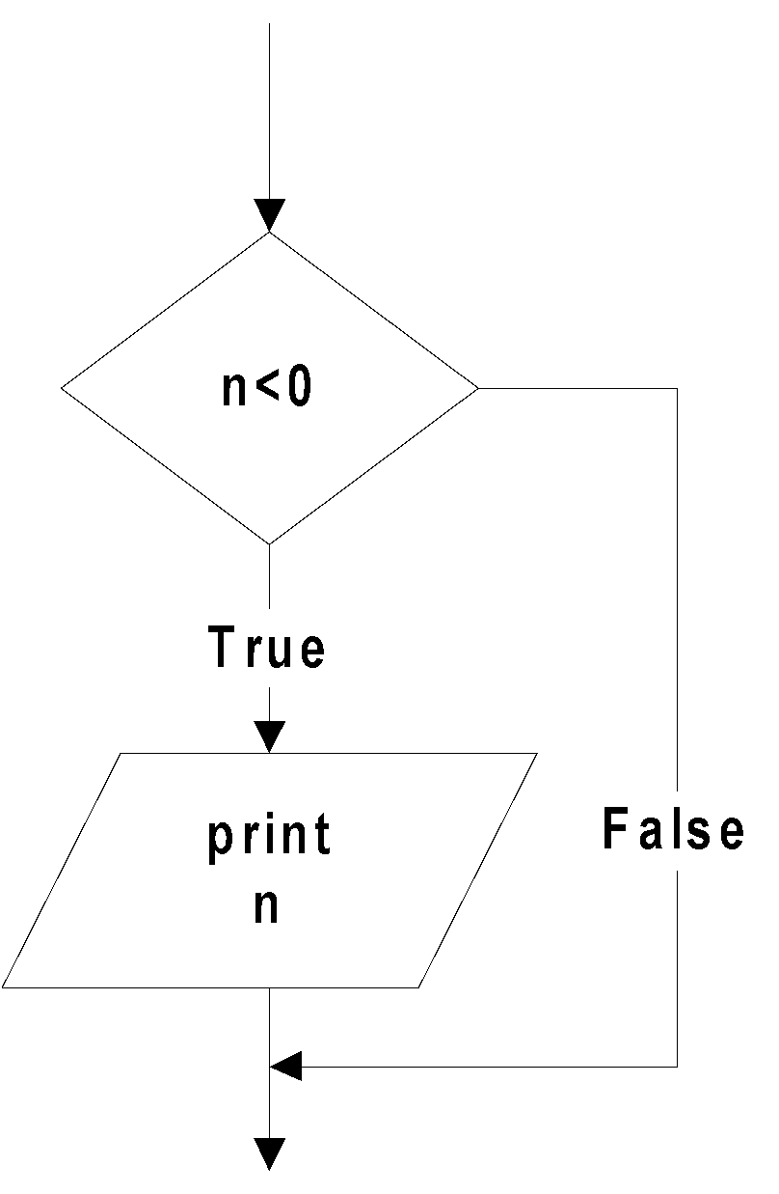
Translating flowchart to C++ code
Example 1: Printing a number only if it is a negative
if (n<0)
{
cout << n;
}

Slide 50
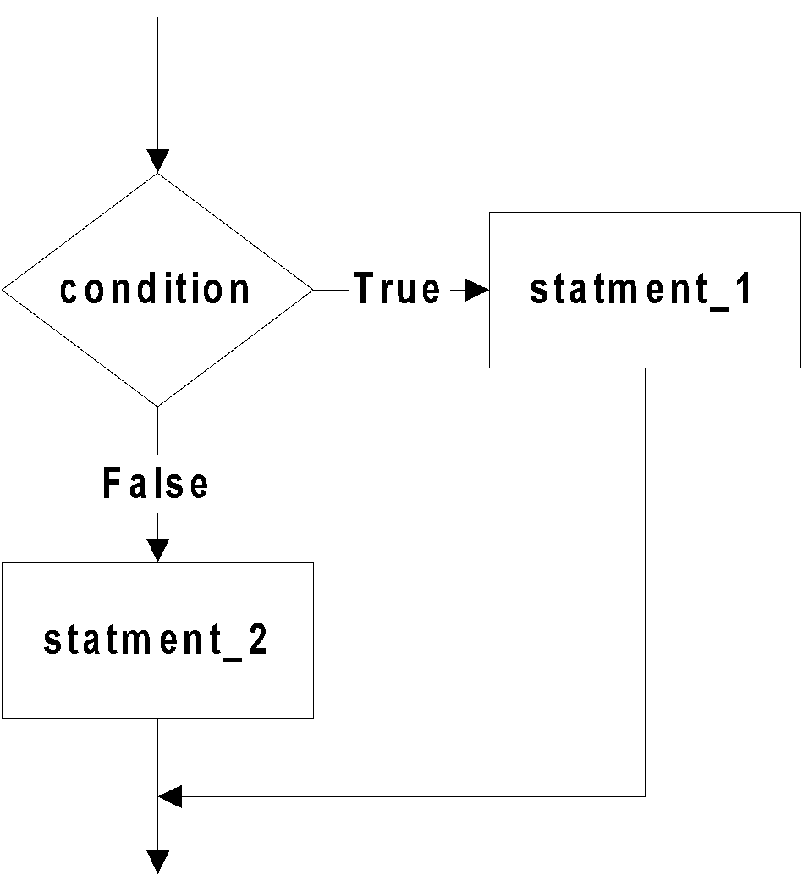
Translating flowchart to C++ code
Pattern 2
if (condition)
{
statement_1;
}
else
{
statement_2;
}

Slide 51
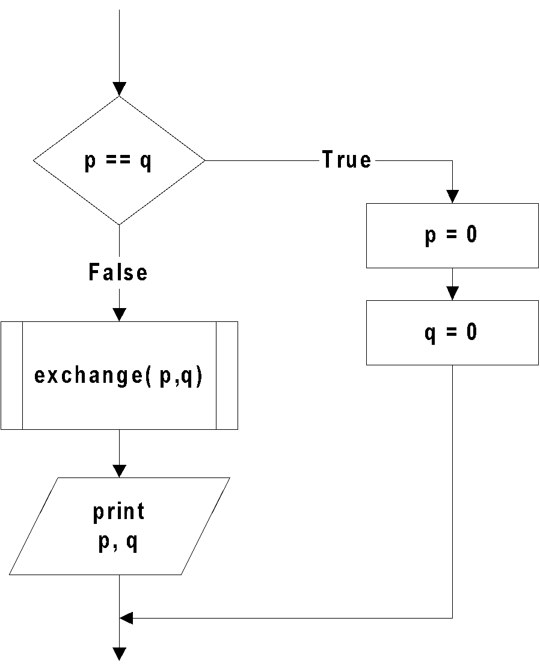
Translating flowchart to C++ code
Example 2: If two numbers (p and q) are equivalent reset them to zero, otherwise exchange or swap their value each other and then print the new values.
if (p==q)
{
p = 0;
q = 0;
}
else
{
exchange(&p,&q);
cout << p << q;
}

Slide 52
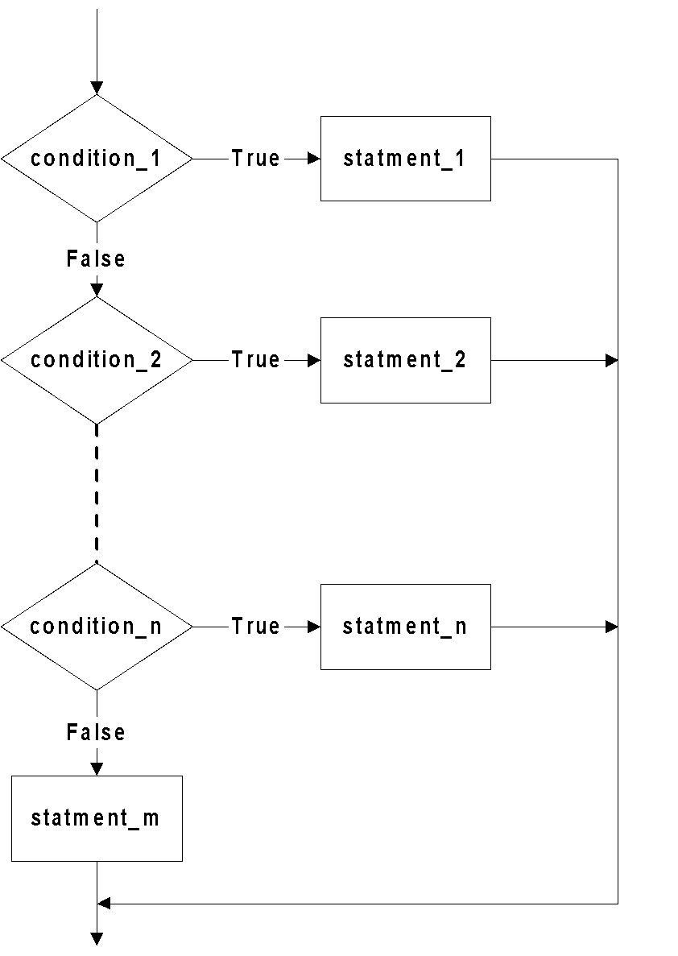
Translating flowchart to C++ code
if (condition_1)
{
statement_1;
}
else if (condition_2)
{
statement_2;
}
else if (condition_n)
{
statement_n;
}
else
{
statement_m;
}
Pattern 3

Slide 53
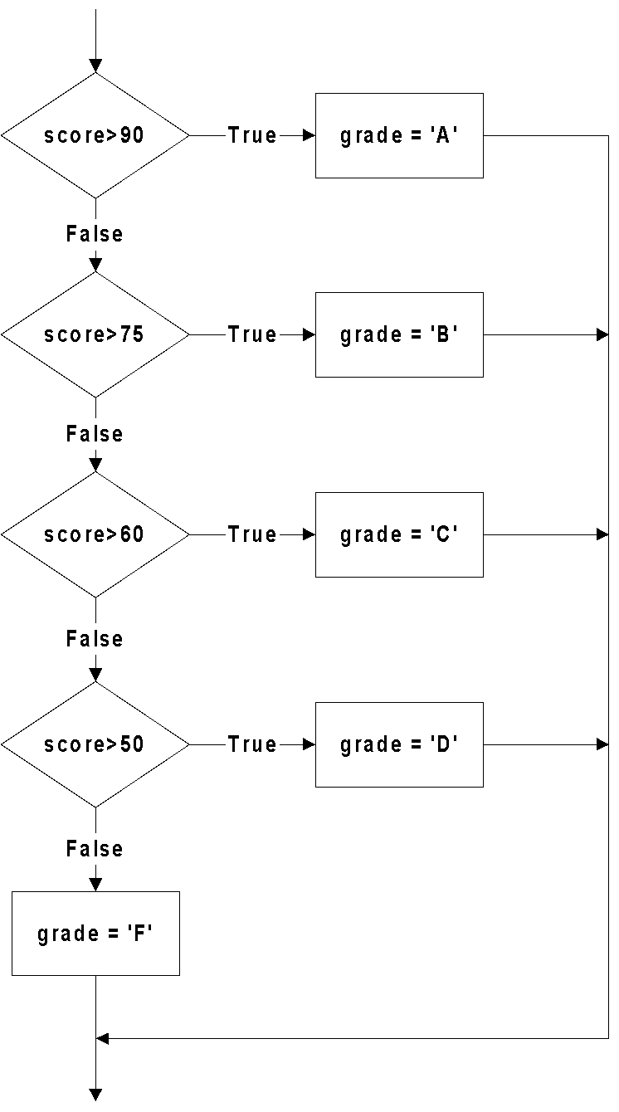
Translating flowchart to C++ code
Example 3: Identifying the grade of a score
if (score > 90)
{
grade = 'A';
}
else if (score > 75)
{
grade = 'B';
}
else if (score > 60)
{
grade = 'C';
}
else if (score > 50)
{
grade = 'D';
}
else
{
grade = 'F';
}

Slide 54
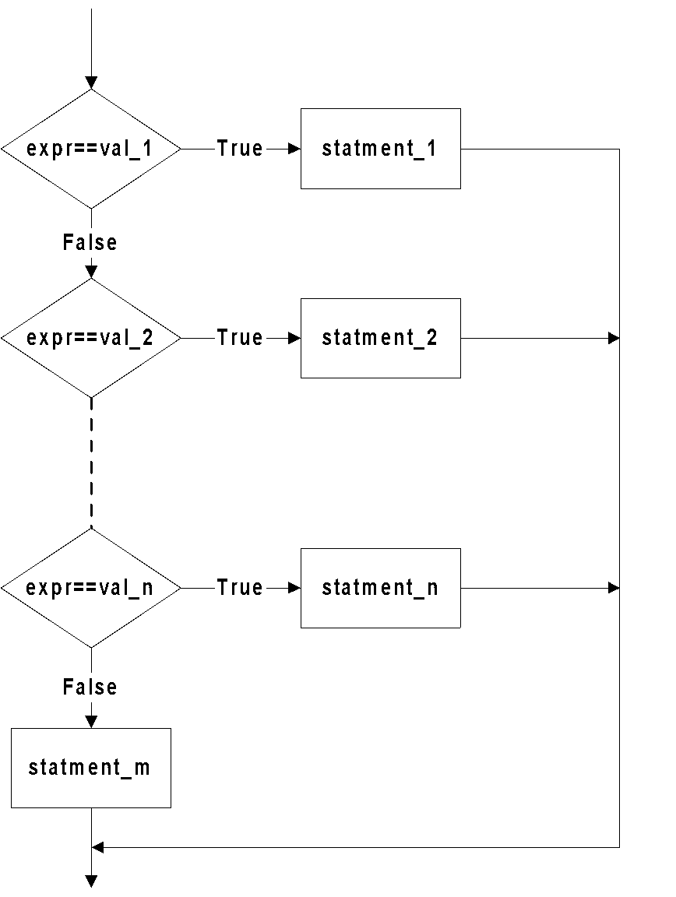
Translating flowchart to C++ code
Pattern 4
The conditions must be in this form:
    expression == value
switch (expr)
{
case val_1 : statement_1;
break;
case val_2 : statement_2;
break;
case val_n : statement_n;
break;
default: statement_m;
break;
}

Slide 55
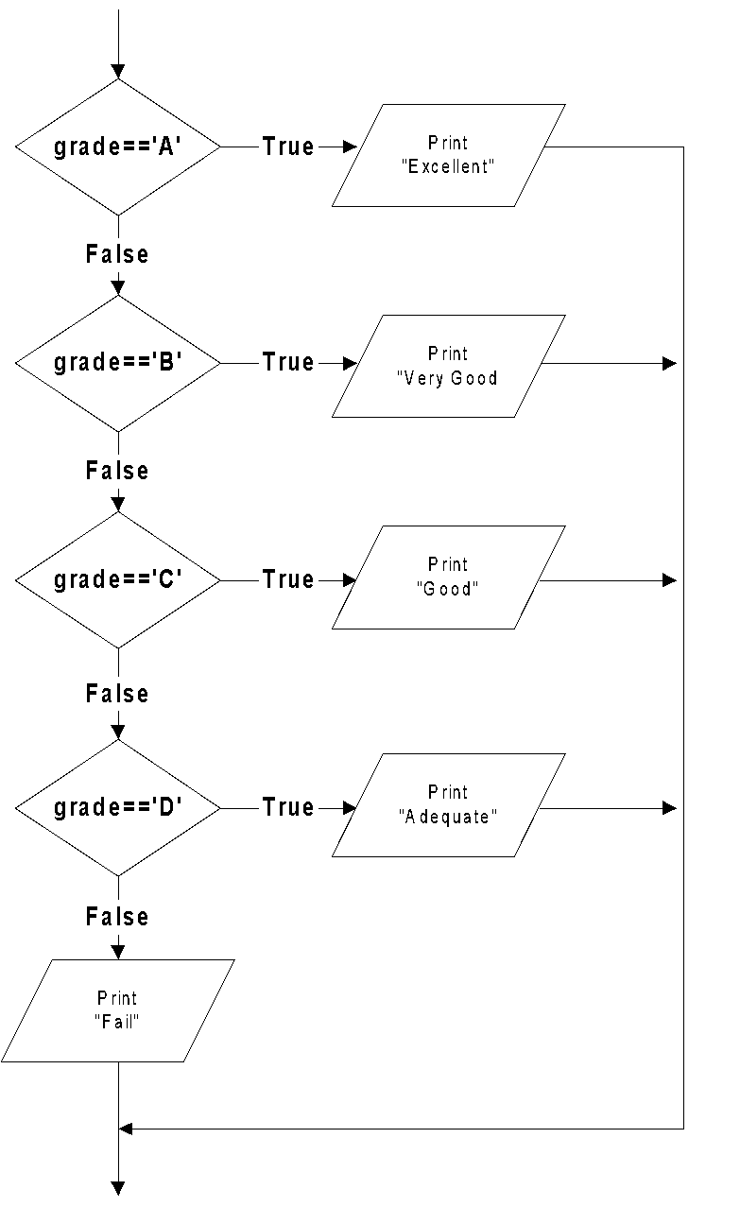
Translating flowchart to C++ code
Example 4: Printing the description of a grade.
switch (grade)
{
case 'A‘ : cout << "Excellent!";
break;
case 'B' : cout << "Very good!";
break;
case 'C' : cout << "Good";
break;
case 'D' : cout << "Adequate";
break;
default : cout << "Fail";
break;
}

Slide 56
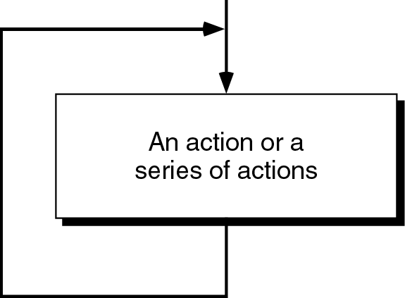
Loop / Repetition
The main idea of a loop is to repeat an action or a series of actions.
The concept of a loop

Slide 57
Loops
But, when to stop looping?
In the following flowchart, the action is executed over and over again. It never stop – This is called an infinite loop
Solution – put a condition to tell the loop either continue looping or stop.

Slide 58
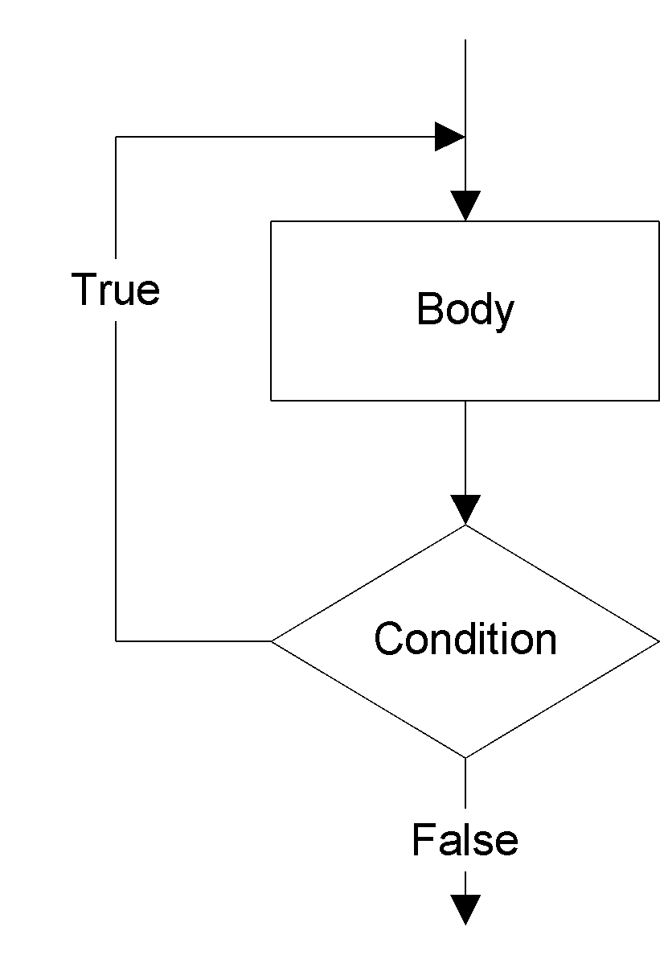
Loops
A loop has two parts – body and condition
Body – a statement or a block of statements that will be repeated.
Condition – is used to control the iteration – either to continue or stop iterating.

Slide 59
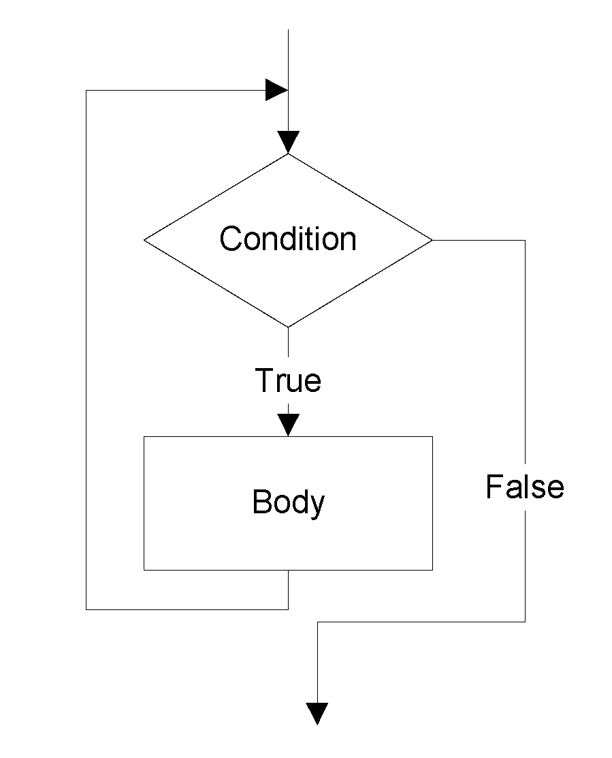
Types of loop
Two forms of loop – pretest loop and post-test loop.
Pretest loop
  the condition is tested first, before we start executing the body.
  The body is executed if the condition is true.
  After executing the body, the loop repeats
Pretest loop
Here must be a “True”

Slide 60
Types of loop
Post-test loop
  the condition is tested later, after executing the body.
  If the condition is true, the loop repeats, otherwise it terminates.
  The body is always executed at least once.
Post-test loop
The iterating part must be a “True”

Slide 61
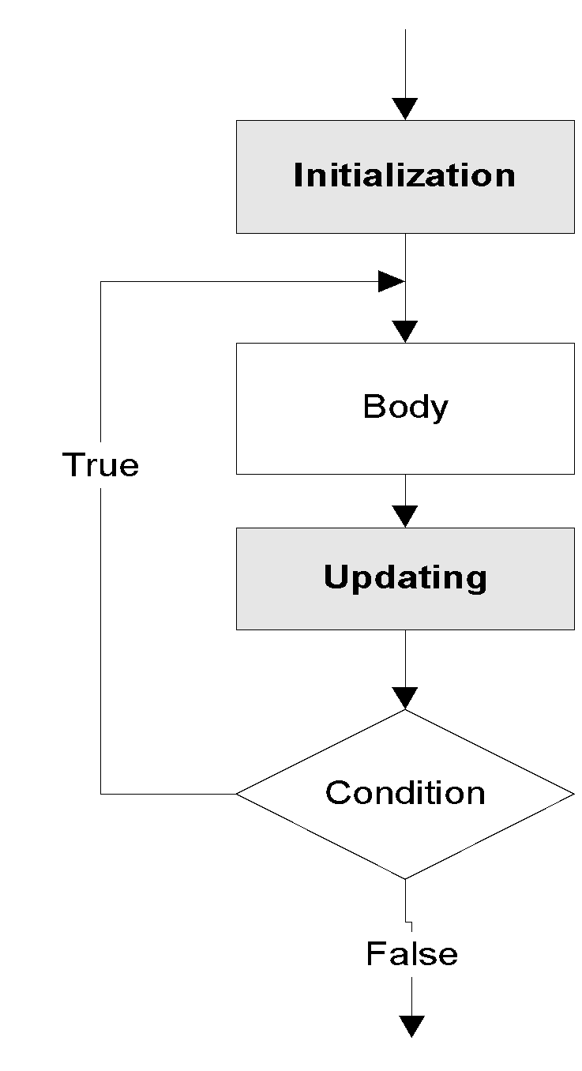
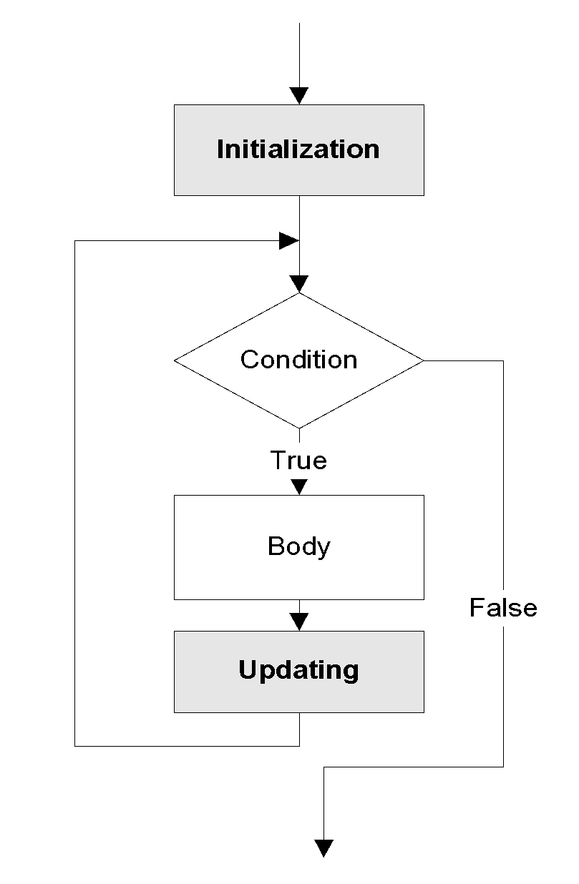
Parts of a loop
Beside the body and condition, a loop may have two other parts – Initialization and Updating
Pretest loop
Post-test loop

Slide 62
Parts of a loop
Initialization
  is used to prepare a loop before it can start –usually, here we initialize the condition
  The initialization must be written outside of the loop – before the first execution of the body.
Updating
  is used to update the condition
  If the condition is not updated, it always true => the loop always repeats – an infinite loop
  The updating part is written inside the loop – it is actually a part of the body.

Slide 63
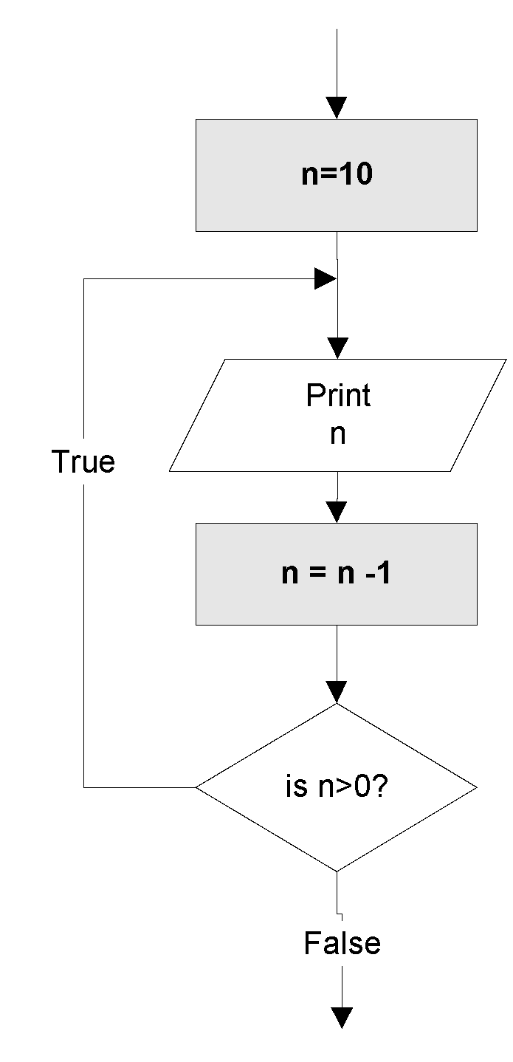
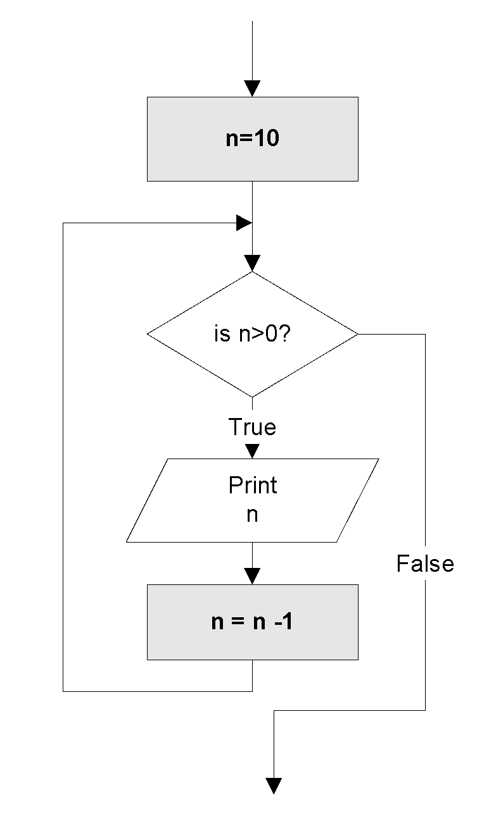
Parts of a loop
Example: These flowcharts print numbers 10 down to 1
Pretest loop
Post-test loop
Initialize n before start the loop
Every time the loop repeats, n is updated

Slide 64
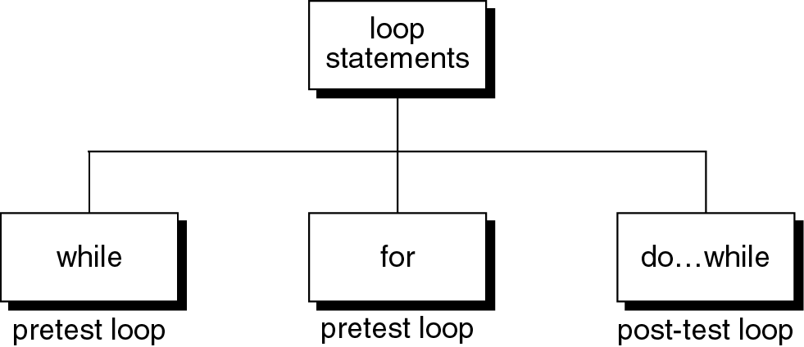
Loop statements
C++ provides three loop statements:
C++ loop constructs

Slide 65
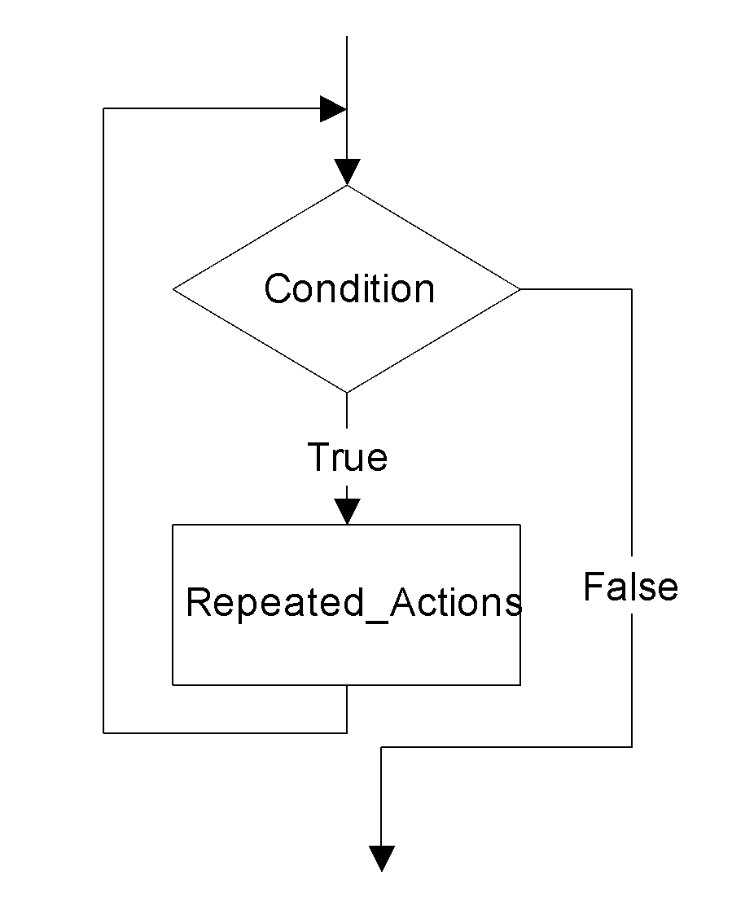
while statement
while flowchart
while (Condition)
{
Repeated_Actions;
}

Slide 66
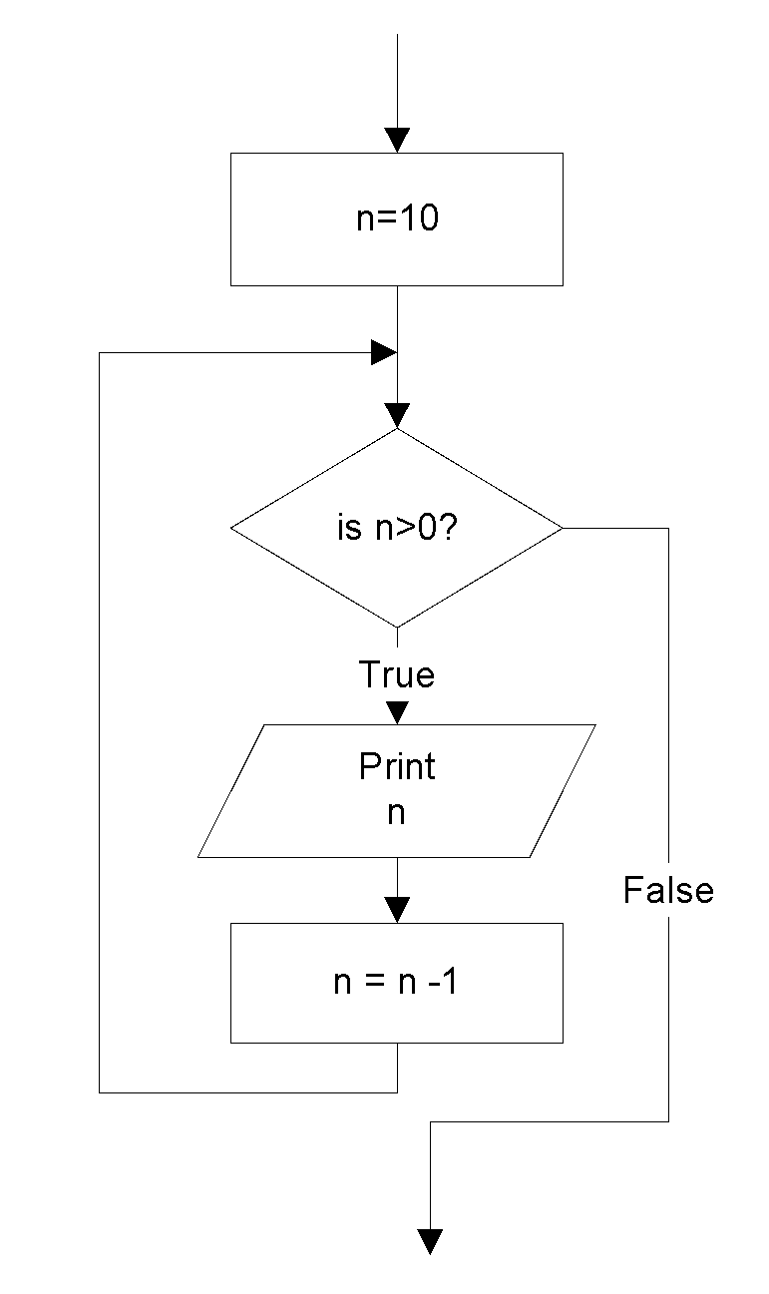
while statement
Example: This while statement prints numbers 10 down to 1
Note that, the first line (n=10) is
actually not a part of the loop statement.
n=10;
while (n>0)
{
cout << n <<“ “;
n=n-1;
}
Output:
10 9 8 7 6 5 4 3 2 1

Slide 67

for statement
for flowchart
for (Initialization; Condition; Updating)
{
Repeated_Actions;
}

Slide 68
for statement
Example: This for statement prints numbers 10 down to 1
for (n=10; n>0; n=n-1)
{
cout << n <<“ “;
}
Output:
10 9 8 7 6 5 4 3 2 1

Slide 69
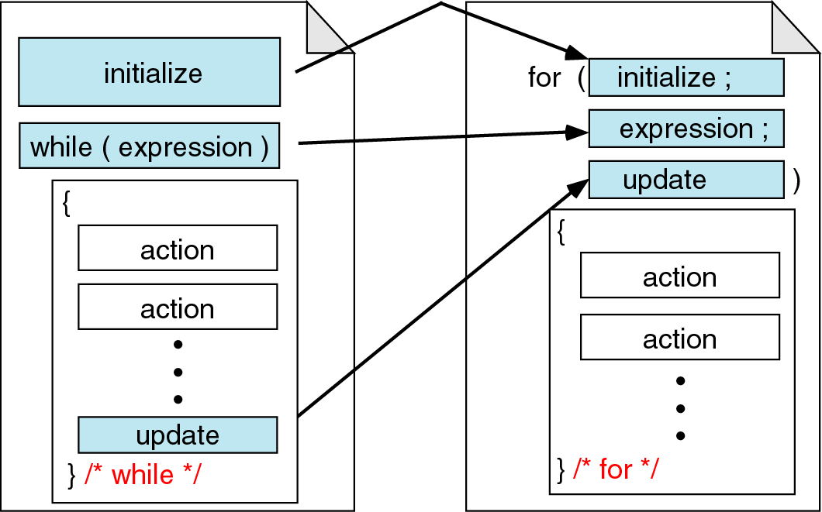
for vs. while statements
Comparing for and while loops

Slide 70
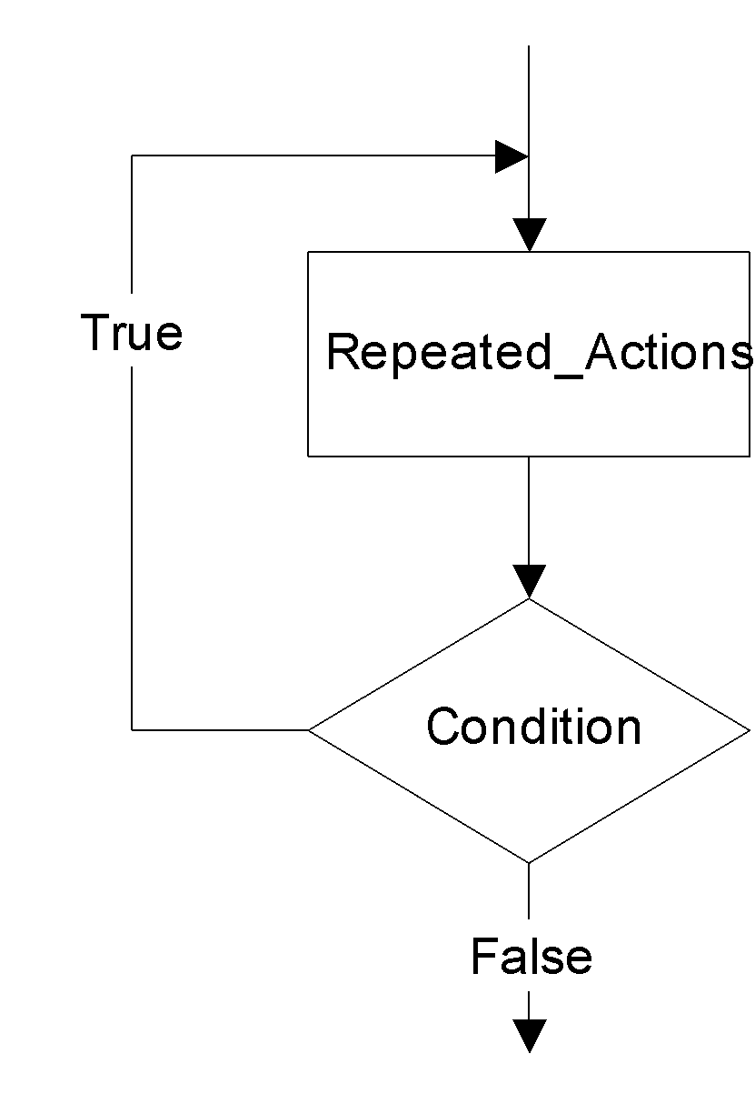
do…while statement
do
{
Repeated_Actions;
} while (Condition);

Slide 71

do…while statement
Example: This do…while statement prints numbers 10 down to 1
Note that, the first line (n=10) is
actually not a part of the loop statement.
n=10;
do
{
cout << n << “ “;
n=n-1;
} while (n>0);
Output:
10 9 8 7 6 5 4 3 2 1

Slide 72
Loop statements
If the body part has only one statement, then the bracket symbols, { } may be omitted.
Example: These two for statements are equivalent.
for (n=10; n>0; n=n-1)
{
cout << n;
}
for (n=10; n>0; n=n-1)
cout << n;

Slide 73
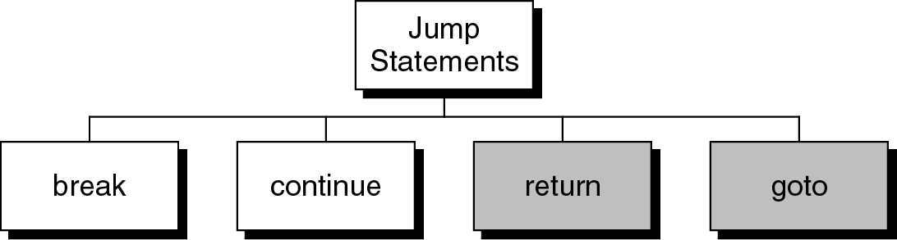
Jump statements
You have learn that, the repetition of a loop is controlled by the loop condition.
C++ provides another way to control the loop, by using jump statements.
There are four jump statements:

Slide 74
Breaking Out of a Loop
Can use break to terminate execution of a loop
Use sparingly if at all – makes code harder to understand
When used in an inner loop, terminates that loop only and returns to the outer loop
Notes:
See pr5-15.cpp

Slide 75
break statement
It causes a loop to terminate
Example:
for (n=10; n>0; n=n-1)
{
if (n<8) break;
cout << n << “ “;
}
Output:
10 9 8

Slide 76
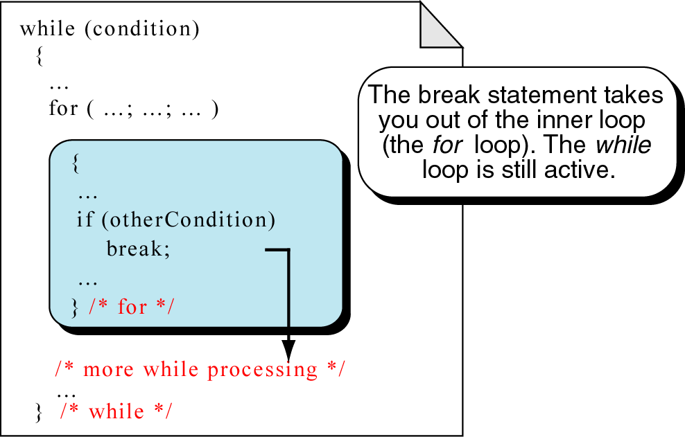
break statement
break an inner loop

Slide 77
The continue Statement
Can use continue to go to end of loop and prepare for next repetition
  while and do-while loops go to test and repeat the loop if test condition is true
  for loop goes to update step, then tests, and repeats loop if test condition is true
Use sparingly – like break, can make
program logic hard to follow
Notes:
See pr5-16.cpp

Slide 78
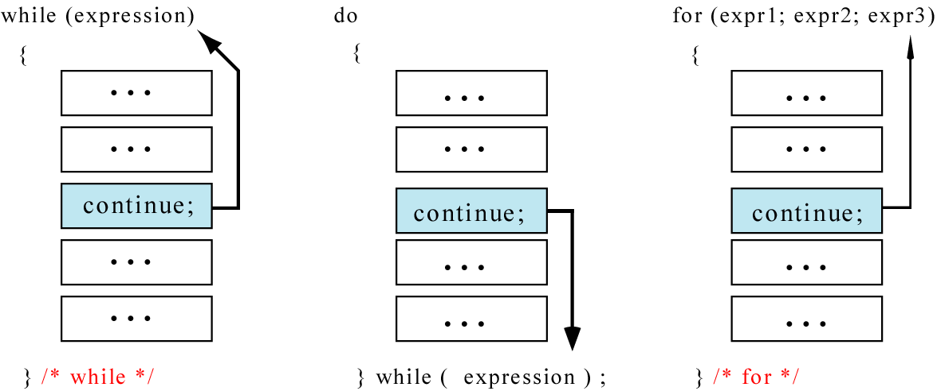
continue statement
In while and do…while loops, the continue statement transfers the control to the loop condition.
In for loop, the continue statement transfers the control to the updating part.
The continue statement

Slide 79
continue statement
Example:
for (n=10; n>0; n=n-1)
{
if (n%2==1) continue;
cout << n <<“ “;
}
Output:
10 8 6 4 2

Slide 80
continue statement
Example:
n = 10;
while (n>0)
{
cout << n << “ “;
if (n%2==1) continue;
n = n –1;
}
Output:
10 9 9 9 9 9 …………
The loop then prints number 9 over and over again. It never stops.

Slide 81
return statement
You will learn this statement in Chapter 4 – Function.
It causes a function to terminate.
Example:
void print_numbers()
{ int n=10;
int i;
while (n>0)
{
for (i=n;i>0; i--)
{
if (i%2==1) continue;
if (i%4==0) break;
if (n==6) return;
cout <<i <<“ “;
}
cout << endl;
n=n-1;
}
}
Output:
10
6
The continue statement transfers control to the updating part ( i-- )
The break statement terminates the for loop.
The return statement terminates the function and returns to the caller.

Slide 82
return statement
When to use return?
Example: the following functions are equivalent
float calc_point(char grade)
{
float result;
if (grade=='A') result = 4.0;
else if (grade=='B') result = 3.0;
else if (grade=='C') result = 2.5;
else if (grade=='D') result = 2.0;
else result = 0.0;
return result;
}
float calc_point(char grade)
{
if (grade=='A') return 4.0;
if (grade=='B') return 3.0;
if (grade=='C') return 2.5;
if (grade=='D') return 2.0;
return 0.0;
}
The else part of each if statement may be omitted. It has never been reached.

Slide 83
return statement
float calc_point3(char grade)
{
float result;
switch (grade)
{
case 'A': result = 4.0;
break;
case 'B': result = 3.0;
break;
case 'C': result = 2.5;
break;
case 'D': result = 2.0;
break;
default: result =0.0;
}
return result;
}
float calc_point4(char grade)
{
switch (grade)
{
case 'A': return 4.0;
case 'B': return 3.0;
case 'C': return 2.5;
case 'D': return 2.0;
}
return 0.0;
}
The break statement of each case may be omitted. It has never been reached.

Slide 84
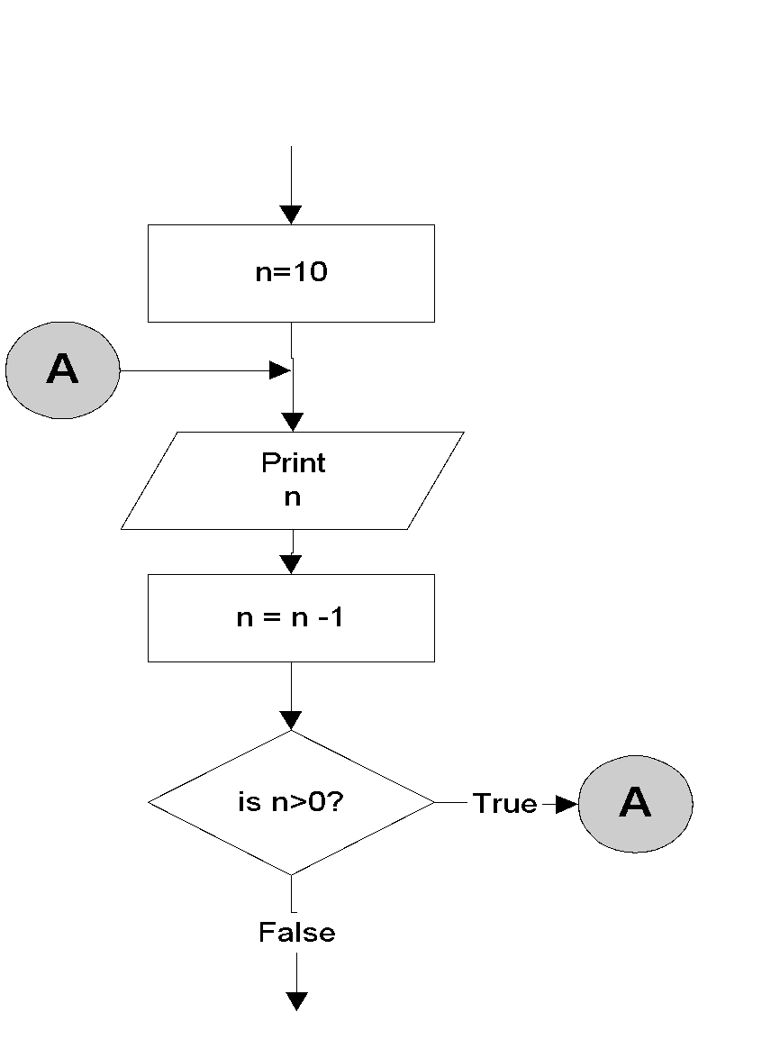
goto statement
It is used to translate connector symbols – jump to another part inside a program.
But, it is not recommended to use - it may cause unstructured programs.
Example:
n=10;
A:
cout <<n <<“ “;
n = n -1;
if (n>0) goto A;
Output:
10 9 8 7 6 5 4 3 2 1

Slide 85

Translating flowchart to C++ code
Pattern 1
Here must be a “False”
while (condition)
{
Repeated_Actions;
}
Here must be a “True”

Slide 86
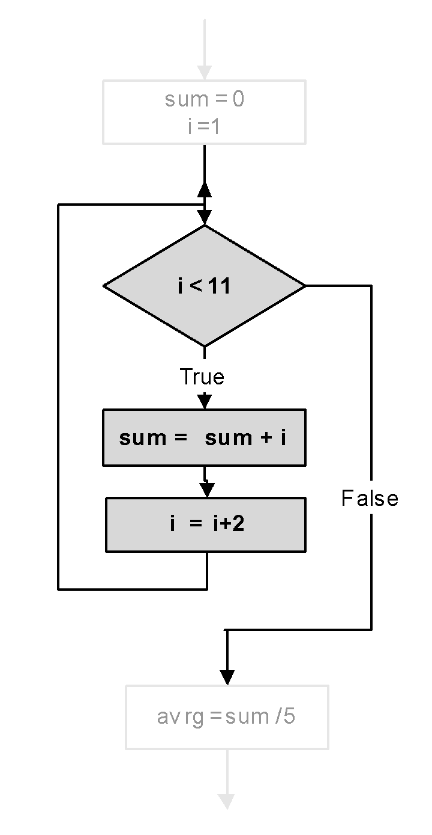
Translating flowchart to C++ code
Example: Calculate the average of odd numbers 1 to 9
sum = 0;
i=1;
while (i<11)
{
sum = sum + i;
i = i + 2;
}
avrg = sum/5.0;

Slide 87
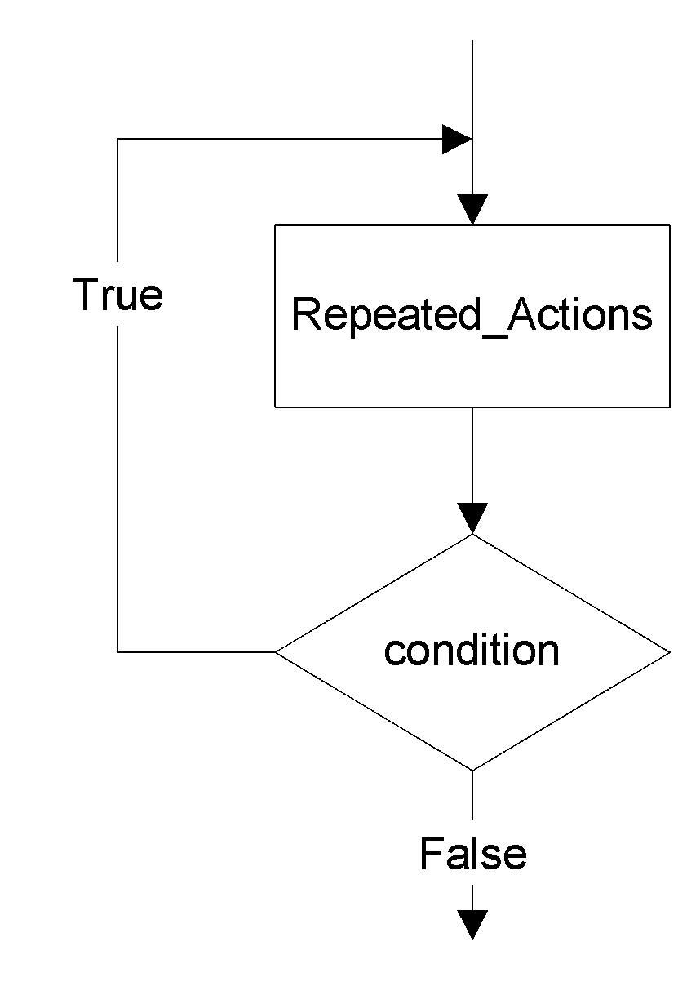
Translating flowchart to C++ code
Pattern 2
do
{
Repeated_Actions;
} while(condition);
The iterating part must be a “True”

Slide 88
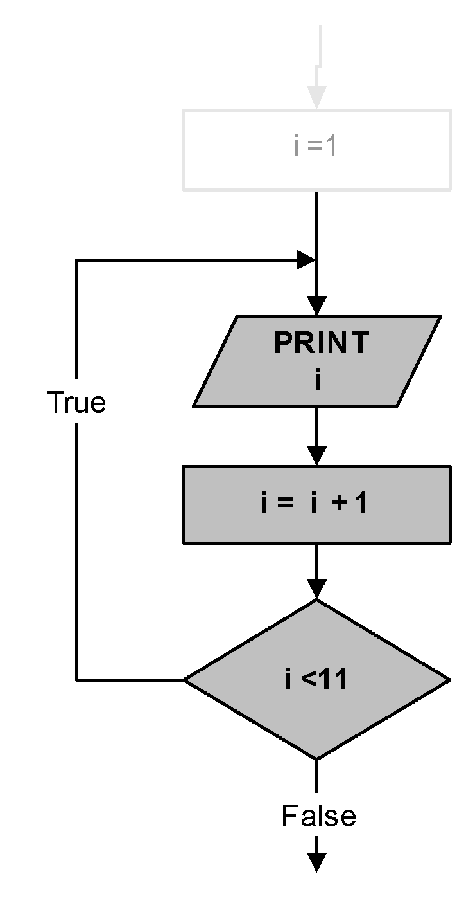
Translating flowchart to C++ code
Example: Prints numbers 1 to 10
i=1;
do
{
cout <<i <<endl;
i = i + 1;
} while (i<11);

Slide 89

Translating flowchart to C++ code
Pattern 3
for (initialize; condition; update)
{
Repeated_Actions;
}
or
initialize;
while (condition)
{
Repeated_Actions;
update;
}

Slide 90
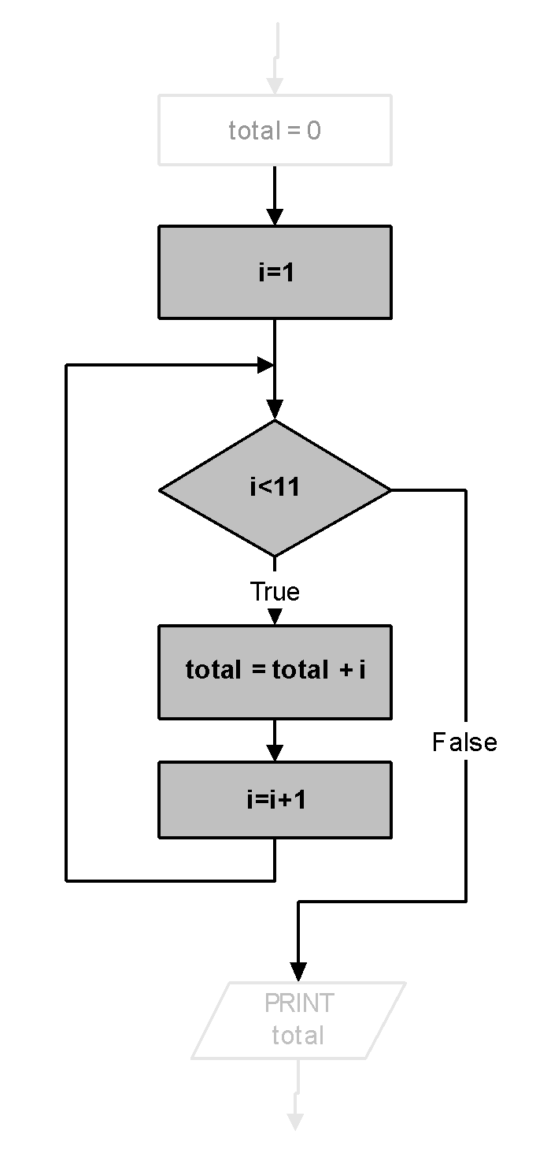
Translating flowchart to C++ code
Example: Print the total of numbers 1 to 10
total = 0;
for (i=1; i<11; i++)
{
total = total + i;
}
cout <<total;
or
total = 0;
i=1;
while (i<11)
{
total = total + i;
i++;
}
cout <<total;

Slide 91
Deciding Which Loop to Use
while: pretest loop (loop body may not be executed at all)
do-while: post test loop (loop body will always be executed at least once)
for: pretest loop (loop body may not be executed at all); has initialization and update code; is useful with counters or if precise number of repetitions is known

Slide 92
Nested Loops
A nested loop is a loop inside the body of another loop
Example:
  for (row = 1; row <= 3; row++)
  {
  for (col = 1; col <= 3; col++)
  {
  cout << row * col << endl;
  }
  }
outer loop
inner loop
Notes:
See pr5-14.cpp

Slide 93
Notes on Nested Loops
Inner loop goes through all its repetitions for each repetition of outer loop
Inner loop repetitions complete sooner than outer loop
Total number of repetitions for inner loop is product of number of repetitions of the two loops. In previous example, inner loop repeats 9 times

Slide 94
In-Class Exercise
How many times the outer loop is executed? How many times the inner loop is executed? What is the output?
#include <iostream>
using namespace std;
int main()
{ int x, y;
for(x=1;x<=8;x+=2)
for(y=x;y<=10;y+=3)
cout<<"\nx = " <<x << " y = "<<y;
return 0;
}

